Slide 1
Convolutional Neural Networks (CNNs, ConvNets)
CS231n Convolutional Neural Networks for Visual Recognition
CS 230 - Convolutional Neural Networks Cheatsheet (stanford.edu)
https://saturncloud.io/blog/a-comprehensive-guide-to-convolutional-neural-networks-the-eli5-way/
https://medium.com/@himadrisankarchatterjee/a-basic-introduction-to-convolutional-neural-network-8e39019b27c4
Convolutional Neural Networks (CNNs) and Layer Types – PyImageSearch
winter1516_lecture7.pdf (stanford.edu)
https://towardsdatascience.com/a-basic-introduction-to-separable-convolutions-b99ec3102728
https://indoml.com/2018/03/07/student-notes-convolutional-neural-networks-cnn-introduction/

Slide 2
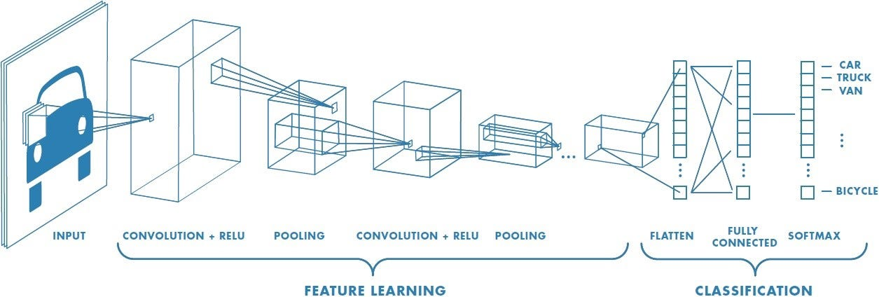
Architecture of a typical CNN

Slide 3
Convolutional Layer (CONV)
標題
Feature map
Activation map

Slide 4
Spatial Filtering
1×1 mask
f (x, y): input image g (x, y): output image
transformation function T

Slide 5
Spatial Filtering
3×3 mask
f (x, y): input image g (x, y): output image
transformation function T
output size ≠ input size

Slide 6
Padding
3×3 mask
f (x, y): input image g (x, y): output image
transformation function T
image padding = 1
output size = input size

Slide 7
Padding, Stride
5×5 mask
f (x, y): input image g (x, y): output image
transformation function T
image padding = 2
stride = 1

Slide 8
Stride
5×5 mask
f (x, y): input image g (x, y): output image
transformation function T
stride = 2
output size = ½ input size
stride = 3 ?
stride = ½ ?
image padding = 2

Slide 9
Receptive Field
output image

Slide 10
Image Padding Techniques
Zero padding
Mirror(Reflect) padding
Replicate padding
Warp padding
0 | 0 | 0 | 0 | 0 | 0 | 0 | 0
0 | 0 | 0 | 0 | 0 | 0 | 0 | 0
0 | 0 | 88 | 89 | 77 | 56 | 0 | 0
0 | 0 | 86 | 93 | 88 | 66 | 0 | 0
0 | 0 | 99 | 99 | 88 | 88 | 0 | 0
0 | 0 | 66 | 67 | 67 | 69 | 0 | 0
0 | 0 | 0 | 0 | 0 | 0 | 0 | 0
0 | 0 | 0 | 0 | 0 | 0 | 0 | 0
88 | 99 | 99 | 99 | 88 | 88 | 88 | 99
88 | 93 | 86 | 93 | 88 | 66 | 88 | 93
77 | 89 | 88 | 89 | 77 | 56 | 77 | 89
88 | 93 | 86 | 93 | 88 | 66 | 88 | 93
88 | 99 | 99 | 99 | 88 | 88 | 88 | 99
67 | 67 | 66 | 67 | 67 | 69 | 67 | 67
88 | 99 | 99 | 99 | 88 | 88 | 88 | 99
88 | 93 | 86 | 93 | 88 | 66 | 88 | 93
93 | 86 | 86 | 93 | 88 | 66 | 66 | 88
89 | 88 | 88 | 89 | 77 | 56 | 56 | 77
89 | 88 | 88 | 89 | 77 | 56 | 56 | 77
93 | 86 | 86 | 93 | 88 | 66 | 66 | 88
99 | 99 | 99 | 99 | 88 | 88 | 88 | 88
67 | 66 | 66 | 67 | 67 | 69 | 69 | 67
67 | 66 | 66 | 67 | 67 | 69 | 69 | 67
99 | 99 | 99 | 99 | 88 | 88 | 88 | 88
88 | 88 | 99 | 99 | 88 | 88 | 99 | 99
67 | 69 | 66 | 67 | 67 | 69 | 66 | 67
77 | 56 | 88 | 89 | 77 | 56 | 88 | 89
88 | 66 | 86 | 93 | 88 | 66 | 86 | 93
88 | 88 | 99 | 99 | 88 | 88 | 99 | 99
67 | 69 | 66 | 67 | 67 | 69 | 66 | 67
77 | 56 | 88 | 89 | 77 | 56 | 88 | 89
88 | 66 | 86 | 93 | 88 | 66 | 86 | 93
Constant padding
55 | 55 | 55 | 55 | 55 | 55 | 55 | 55
55 | 55 | 55 | 55 | 55 | 55 | 55 | 55
55 | 55 | 88 | 89 | 77 | 56 | 55 | 55
55 | 55 | 86 | 93 | 88 | 66 | 55 | 55
55 | 55 | 99 | 99 | 88 | 88 | 55 | 55
55 | 55 | 66 | 67 | 67 | 69 | 55 | 55
55 | 55 | 55 | 55 | 55 | 55 | 55 | 55
55 | 55 | 55 | 55 | 55 | 55 | 55 | 55
88 | 89 | 77 | 56
86 | 93 | 88 | 66
99 | 99 | 88 | 88
66 | 67 | 67 | 69
Input image

Slide 11
Pooling Layer (POOL)
Type | Max pooling | Average pooling
Purpose | Each pooling operation selects the maximum value of the current view | Each pooling operation averages the values of the current view
Illustration
Comments | • Preserves detected features • Most commonly used | • Downsamples feature map • Used in LeNet

Slide 12
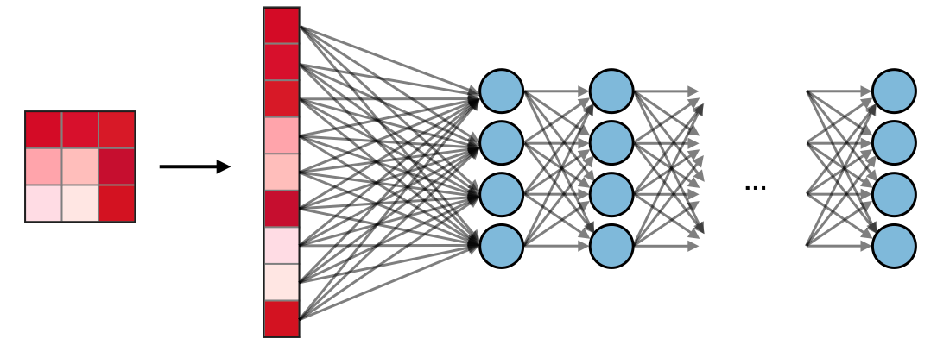
Fully-Connected Layer (FC)
flattened input

Slide 13
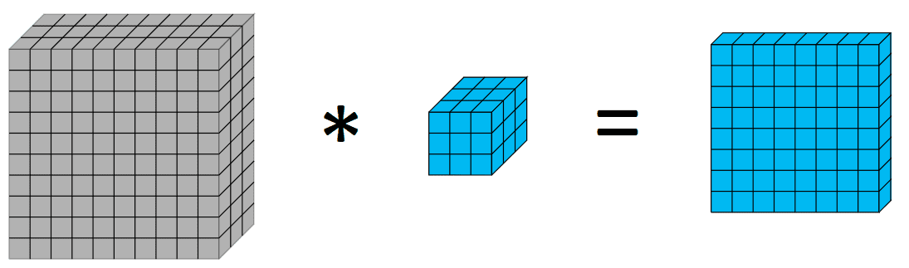
Standard Convolution: filters always extend the full depth of the input volume

Slide 14
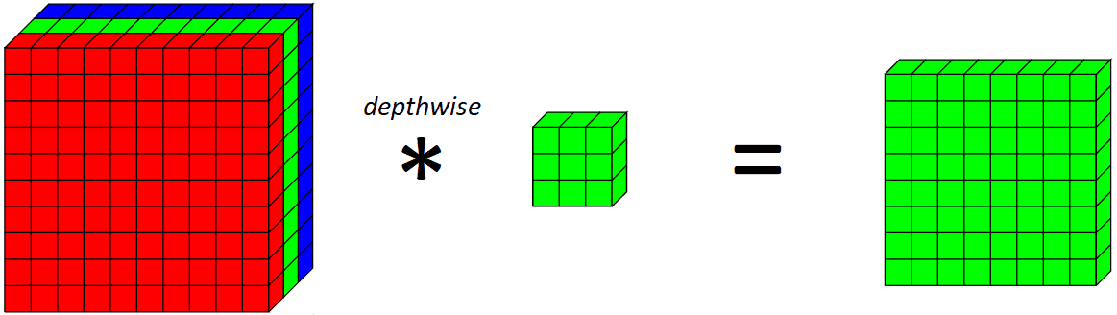
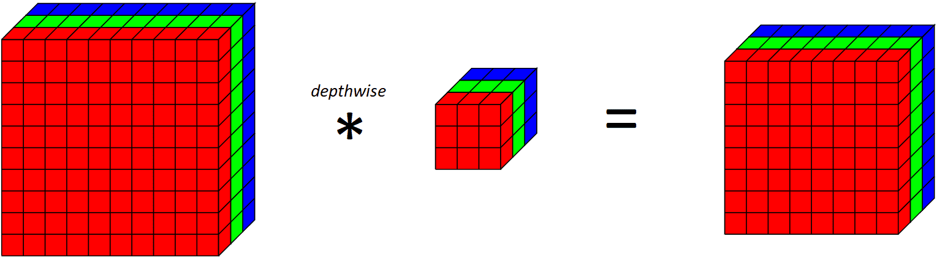
Depth-wise Convolution

Slide 15
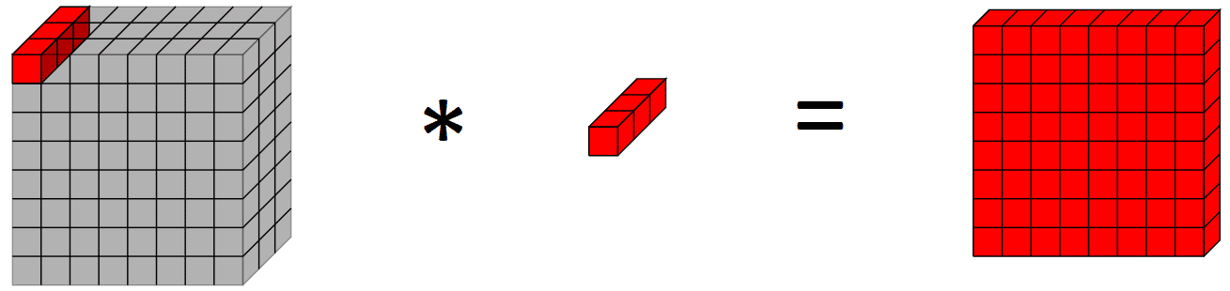
Pixel-wise Convolution (1×1 filter)

Slide 16
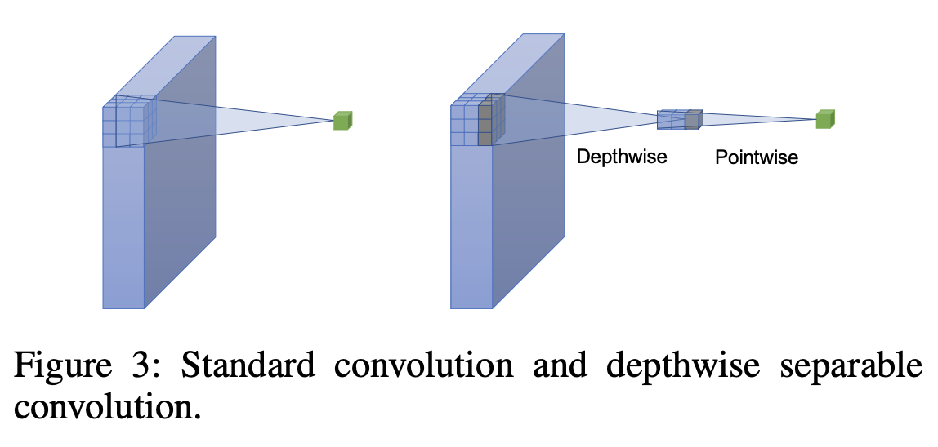
Depth-wise Separable Convolutions https://machinelearningmastery.com/using-depthwise-separable-convolutions-in-tensorflow/

Slide 17
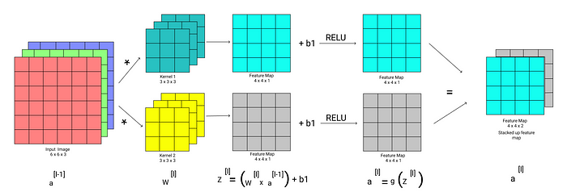
Convolution Operation with Multiple Filters

Slide 18
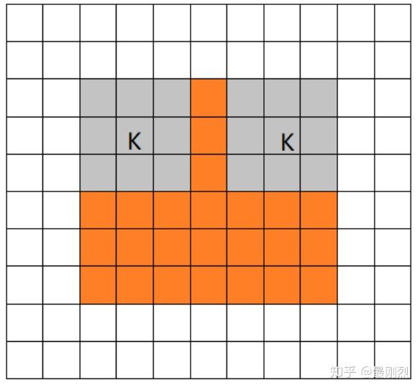
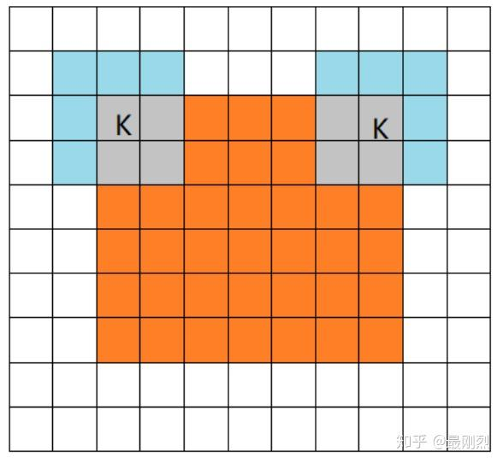
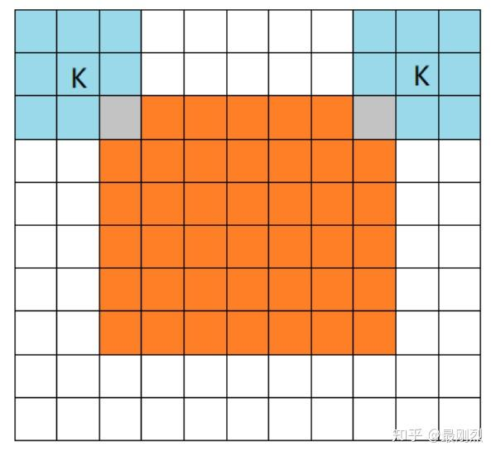
torch.nn.Conv2d() padding
padding controls the amount of padding applied to the input. It can be either a string {‘valid’, ‘same’} or an int / a tuple of ints giving the amount of implicit padding applied on both sides.
torch.nn.Conv2d(in_channels, out_channels, kernel_size, stride=1, padding=0, dilation=1, groups=1, bias=True, padding_mode='zeros', device=None, dtype=None)
padding (int, tuple or str, optional) – Padding added to all four sides of the input. Default: 0
padding_mode (str, optional) – 'zeros', 'reflect', 'replicate' or 'circular'. Default: 'zeros'
Mode | valid | same | full
Illustration

Slide 19
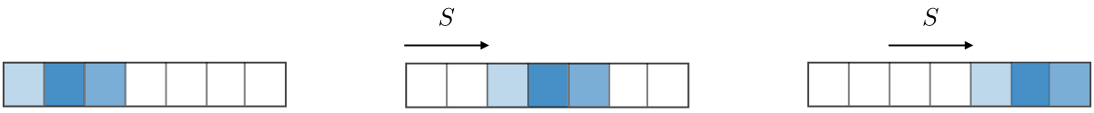
Stride
For a convolutional or a pooling operation, the stride S denotes the number of pixels by which the window moves after each operation.

Slide 20
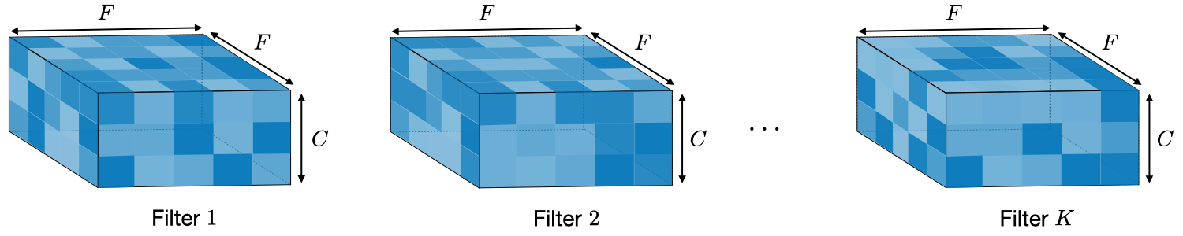
Filter hyperparameters
A filter of size F×F applied to an input containing C channels is a F×F×C volume that performs convolutions on an input of size I×I×C and produces an output feature map (also called activation map) of size O×O×1.
The application of K filters of size F×F results in an output feature map of size O×O×K.

Slide 21
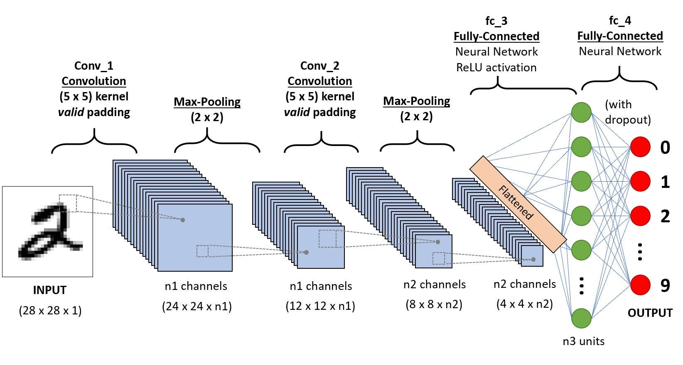
CNN

Slide 22
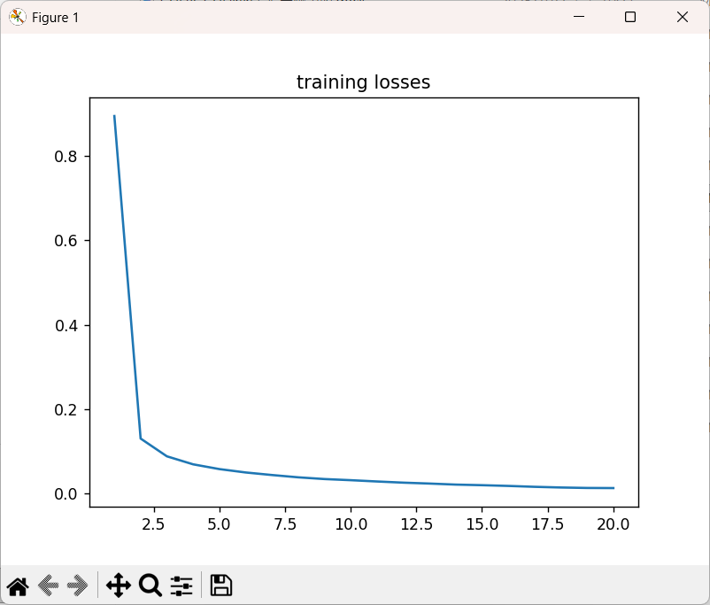
Lab 1 mnistCNN.py
import torch import torch.nn as nn import torch.nn.functional as F import torch.optim as optim import torchvision import torchvision.transforms as transforms import numpy as np import matplotlib.pyplot as plt import time device = ( "cuda" if torch.cuda.is_available() else "cpu" ) print(f"Using {device} device") batch_size = 16 trainset = torchvision.datasets.MNIST(root='..\\data', train=True, download=True, transform=transforms.ToTensor()) trainloader = torch.utils.data.DataLoader(trainset, batch_size=batch_size, shuffle=True, num_workers = 0) testset = torchvision.datasets.MNIST(root='..\\data', train=False, download=True, transform=transforms.ToTensor()) testloader = torch.utils.data.DataLoader(testset, batch_size=batch_size, shuffle=False, num_workers = 0) classes = ('0', '1', '2', '3', '4', '5', '6', '7', '8', '9') # get some random training images dataiter = iter(trainloader) images, labels = next(dataiter) # show images img = torchvision.utils.make_grid(images) npimg = img.numpy() plt.title(' '.join('%5s' % classes[labels[j]] for j in range(batch_size))) plt.imshow(np.transpose(npimg, (1, 2, 0))) plt.show() class Net(nn.Module): def __init__(self): super(Net, self).__init__() self.conv1 = nn.Conv2d(1, 6, 5) self.pool = nn.MaxPool2d(2, 2) self.conv2 = nn.Conv2d(6, 16, 5) self.fc1 = nn.Linear(16 * 4 * 4, 120) self.fc2 = nn.Linear(120, 84) self.fc3 = nn.Linear(84, 10) def forward(self, x): # 28x28 x = self.pool(F.relu(self.conv1(x))) # 24x24 12x12 x = self.pool(F.relu(self.conv2(x))) # 8x8 4x4 x = x.view(-1, 16 * 4 * 4) x = F.relu(self.fc1(x)) x = F.relu(self.fc2(x)) x = self.fc3(x) return x net = Net().to(device) print(net) criterion = nn.CrossEntropyLoss() optimizer = optim.SGD(net.parameters(), lr=0.001, momentum=0.9) num_epocs = 20 losses=[] # loop over the dataset multiple times startTime = time.time() for epoch in range(num_epocs): running_loss = 0.0 #for i, data in enumerate(trainloader): for i, (X, y) in enumerate(trainloader): # get the inputs inputs, labels = X.to(device), y.to(device) # zero the parameter gradients optimizer.zero_grad() # forward + backward + optimize outputs = net(inputs) loss = criterion(outputs, labels) loss.backward() optimizer.step() running_loss += loss.item() endTime = time.time() - startTime print(f'epoch: {epoch+1} loss:{running_loss/len(trainloader):.4f} time:{endTime}') losses.append(running_loss/len(trainloader)) plt.title('training losses') plt.plot(np.arange(1, num_epocs+1), losses) plt.show() correct = 0 total = 0 with torch.no_grad(): for (X, y) in testloader: images, labels = X.to(device), y.to(device) outputs = net(images) _, predicted = torch.max(outputs.data, 1) total += labels.size(0) correct += (predicted == labels).sum().item() print(f'\nAccuracy of the network on the 10000 test images:{100.0 * correct / total}%')

Slide 23
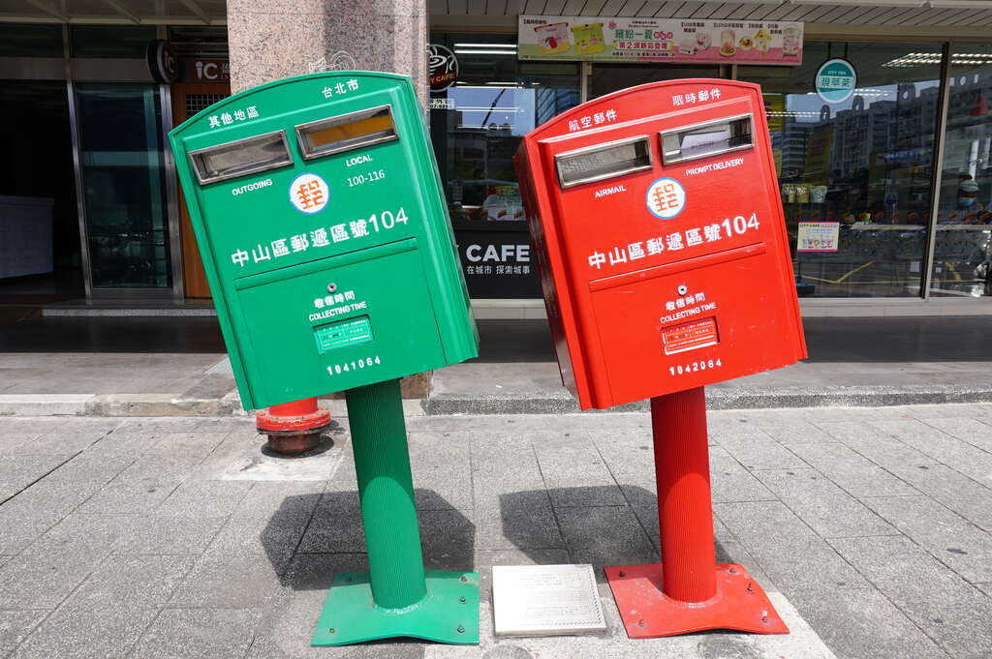
CNN MNIST Classification
Find the problem to be solve (tool to be provided)
Example: Build an automatic letter dispatching system
Kernel program: zip code recognition (郵遞區號辨識)
MNIST dataset / CNN
Establish the system (implementation)
Data
Model
Objective Function
Optimization Algorithm
https://pytorch.org/tutorials/beginner/introyt/introyt1_tutorial.html

Slide 24
Learning path 學習路徑
Run the sample program to check the result
執行範例程式檢視結果
Understand the meaning and usage of each command by tracing the code line by line
追蹤程式碼，查詢並了解每個指令意義與用法

Slide 25
import torch
import torch.nn as nn
import torch.nn.functional as F
import torch.optim as optim
import torchvision
import torchvision.transforms as transforms
import numpy as np
import matplotlib.pyplot as plt
import time
device = (
"cuda"
if torch.cuda.is_available()
else "cpu"
)
print(f"Using {device} device")
batch_size = 16
trainset = torchvision.datasets.MNIST(root='..\\data', train=True, download=True, transform=transforms.ToTensor())
trainloader = torch.utils.data.DataLoader(trainset, batch_size=batch_size, shuffle=True, num_workers = 0)
testset = torchvision.datasets.MNIST(root='..\\data', train=False, download=True, transform=transforms.ToTensor())
testloader = torch.utils.data.DataLoader(testset, batch_size=batch_size, shuffle=False, num_workers = 0)
import 使用到的模組
tensor/model 將被分配到的設備 ：
CPU 或GPU
用torchvision 提供的資料集dataset
https://pytorch.org/vision/stable/datasets.html
https://pytorch.org/vision/stable/generated/torchvision.datasets.MNIST.html#torchvision.datasets.MNIST
用torch.util.data 的DataLoader - Data loader combines a dataset and a sampler, and provides an iterable over the given dataset.
https://pytorch.org/docs/stable/data.html#torch.utils.data.DataLoader

Slide 26
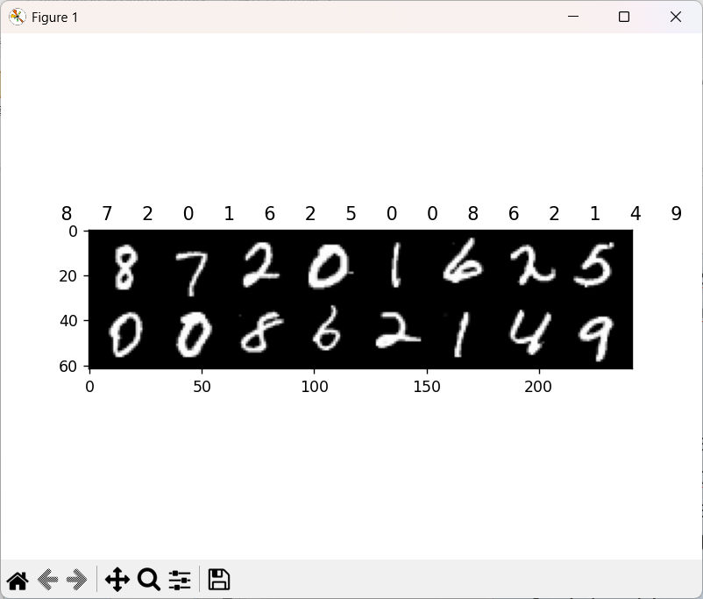
classes = ('0', '1', '2', '3', '4', '5', '6', '7', '8', '9')
# get some random training images
dataiter = iter(trainloader)
images, labels = next(dataiter)
# show images
img = torchvision.utils.make_grid(images)
npimg = img.numpy()
plt.title(' '.join('%5s' % classes[labels[j]] for j in range(batch_size)))
plt.imshow(np.transpose(npimg, (1, 2, 0)))
plt.show()
print(net)
顯示圖案，實際感受一下

Slide 27
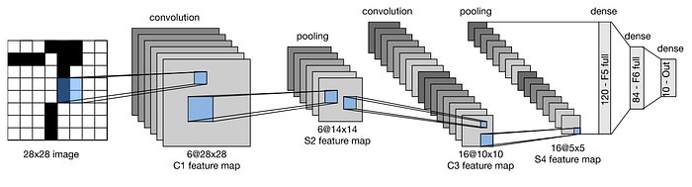
class Net(nn.Module):
def __init__(self):
super(Net, self).__init__()
self.conv1 = nn.Conv2d(1, 6, 5)
self.pool = nn.MaxPool2d(2, 2)
self.conv2 = nn.Conv2d(6, 16, 5)
self.fc1 = nn.Linear(16 * 4 * 4, 120)
self.fc2 = nn.Linear(120, 84)
self.fc3 = nn.Linear(84, 10)
def forward(self, x): # 28x28
x = self.pool(F.relu(self.conv1(x))) # 24x24 12x12
x = self.pool(F.relu(self.conv2(x))) # 8x8 4x4
x = x.view(-1, 16 * 4 * 4)
x = F.relu(self.fc1(x))
x = F.relu(self.fc2(x))
x = self.fc3(x)
return x
net = Net().to(device)
print(net)
定義網路類別
Net(
(conv1): Conv2d(1, 6, kernel_size=(5, 5), stride=(1, 1))
(pool): MaxPool2d(kernel_size=2, stride=2, padding=0, dilation=1, ceil_mode=False)
(conv2): Conv2d(6, 16, kernel_size=(5, 5), stride=(1, 1))
(fc1): Linear(in_features=256, out_features=120, bias=True)
(fc2): Linear(in_features=120, out_features=84, bias=True)
(fc3): Linear(in_features=84, out_features=10, bias=True)
)
列印網路，實際感受一下

Slide 28
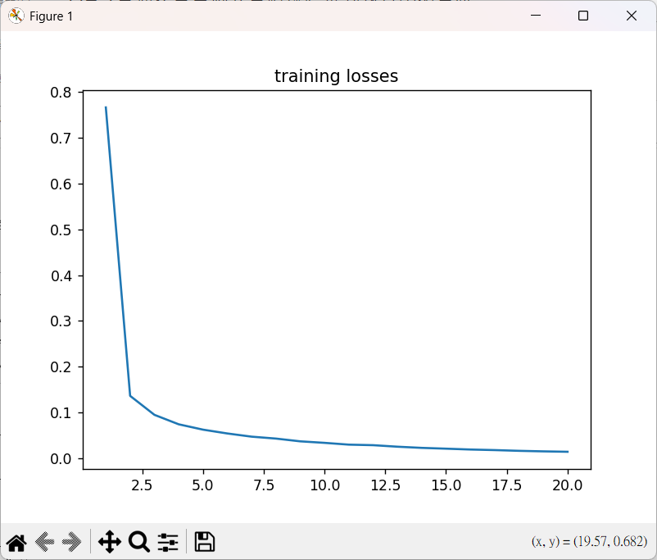
criterion = nn.CrossEntropyLoss()
optimizer = optim.SGD(net.parameters(), lr=0.001, momentum=0.9)
num_epocs = 20
losses=[]
# loop over the dataset multiple times
startTime = time.time()
for epoch in range(num_epocs):
running_loss = 0.0
for i, (X, y) in enumerate(trainloader):
# get the inputs
inputs, labels = X.to(device), y.to(device)
# zero the parameter gradients
optimizer.zero_grad()
# forward + backward + optimize
outputs = net(inputs)
loss = criterion(outputs, labels)
loss.backward()
optimizer.step()
running_loss += loss.item()

Slide 29
endTime = time.time() - startTime
print(f'epoch: {epoch+1} loss:{running_loss/len(trainloader):.4f} time:{endTime}')
losses.append(running_loss/len(trainloader))
plt.title('training losses')
plt.plot(np.arange(1, num_epocs+1), losses)
plt.show()
correct = 0
total = 0
with torch.no_grad():
for (X, y) in testloader:
images, labels = X.to(device), y.to(device)
outputs = net(images)
_, predicted = torch.max(outputs.data, 1)
total += labels.size(0)
correct += (predicted == labels).sum().item()
print(f'\nAccuracy of the network on the 10000 test images:{100.0 * correct / total}%')
epoch: 1 loss:0.7658 time:12.434873580932617
epoch: 2 loss:0.1366 time:24.106077194213867
epoch: 3 loss:0.0952 time:35.85927367210388
epoch: 4 loss:0.0745 time:49.53547549247742
epoch: 5 loss:0.0628 time:64.852548122406
epoch: 6 loss:0.0545 time:80.8273286819458
epoch: 7 loss:0.0476 time:95.73263573646545
epoch: 8 loss:0.0434 time:111.11370730400085
epoch: 9 loss:0.0374 time:125.04886198043823
epoch: 10 loss:0.0341 time:140.46014523506165
epoch: 11 loss:0.0302 time:153.90957117080688
epoch: 12 loss:0.0290 time:169.26028180122375
epoch: 13 loss:0.0257 time:182.89487719535828
epoch: 14 loss:0.0231 time:198.9877061843872
epoch: 15 loss:0.0214 time:212.50299191474915
epoch: 16 loss:0.0195 time:227.9205458164215
epoch: 17 loss:0.0183 time:241.22391366958618
epoch: 18 loss:0.0167 time:256.62231707572937
epoch: 19 loss:0.0155 time:269.73035502433777
epoch: 20 loss:0.0146 time:285.7234671115875
Accuracy of the network on the 10000 test images:98.64%
Process finished with exit code 0

Slide 30
Lab 2 LeNetCIFAR10.py
import torch import torch.nn as nn import torch.nn.functional as F import torch.optim as optim import torchvision import torchvision.transforms as transforms import matplotlib.pyplot as plt import numpy as np class Net(nn.Module): def __init__(self): super(Net, self).__init__() self.conv1 = nn.Conv2d(3, 6, 5) self.pool = nn.MaxPool2d(2, 2) self.conv2 = nn.Conv2d(6, 16, 5) self.fc1 = nn.Linear(16 * 5 * 5, 120) self.fc2 = nn.Linear(120, 84) self.fc3 = nn.Linear(84, 10) def forward(self, x): x = self.pool(F.relu(self.conv1(x))) x = self.pool(F.relu(self.conv2(x))) x = x.view(-1, 16 * 5 * 5) x = F.relu(self.fc1(x)) x = F.relu(self.fc2(x)) x = self.fc3(x) return x transform = transforms.Compose([transforms.ToTensor(), transforms.Normalize((0.5, 0.5, 0.5), (0.5, 0.5, 0.5))]) trainset = torchvision.datasets.CIFAR10(root='./data', train=True, download=True, transform=transform) trainloader = torch.utils.data.DataLoader(trainset, batch_size=4, shuffle=True) testset = torchvision.datasets.CIFAR10(root='./data', train=False, download=True, transform=transform) testloader = torch.utils.data.DataLoader(testset, batch_size=4, shuffle=False) classes = ('plane', 'car', 'bird', 'cat', 'deer', 'dog', 'frog', 'horse', 'ship', 'truck') def imshow(img): img = img / 2 + 0.5 # unnormalize npimg = img.numpy() plt.imshow(np.transpose(npimg, (1, 2, 0))) plt.show() # get some random training images dataiter = iter(trainloader) images, labels = next(dataiter) # show images imshow(torchvision.utils.make_grid(images)) # print labels print(' '.join('%5s' % classes[labels[j]] for j in range(4))) device = "cuda" if torch.cuda.is_available() else "cpu" net = Net().to(device) criterion = nn.CrossEntropyLoss() optimizer = optim.SGD(net.parameters(), lr=0.001, momentum=0.9) epoches = 20 for epoch in range(epoches): # loop over the dataset multiple times running_loss = 0.0 for i, (X, y) in enumerate(trainloader, 0): # get the inputs inputs, labels = X.to(device), y.to(device) # zero the parameter gradients optimizer.zero_grad() # forward + backward + optimize outputs = net(inputs) loss = criterion(outputs, labels) loss.backward() optimizer.step() # print statistics running_loss += loss.item() if i % 2000 == 1999: # print every 2000 mini-batches print('[%d, %5d] loss: %.3f' % (epoch + 1, i + 1, running_loss / 2000)) running_loss = 0.0 print('Finished Training') correct = 0 total = 0 with torch.no_grad(): for (X, y) in testloader: images, labels = X.to(device), y.to(device) outputs = net(images) _, predicted = torch.max(outputs.data, 1) total += labels.size(0) correct += (predicted == labels).sum().item() print('Accuracy of the network on the 10000 test images: %d %%' % (100 * correct / total))

Slide 31
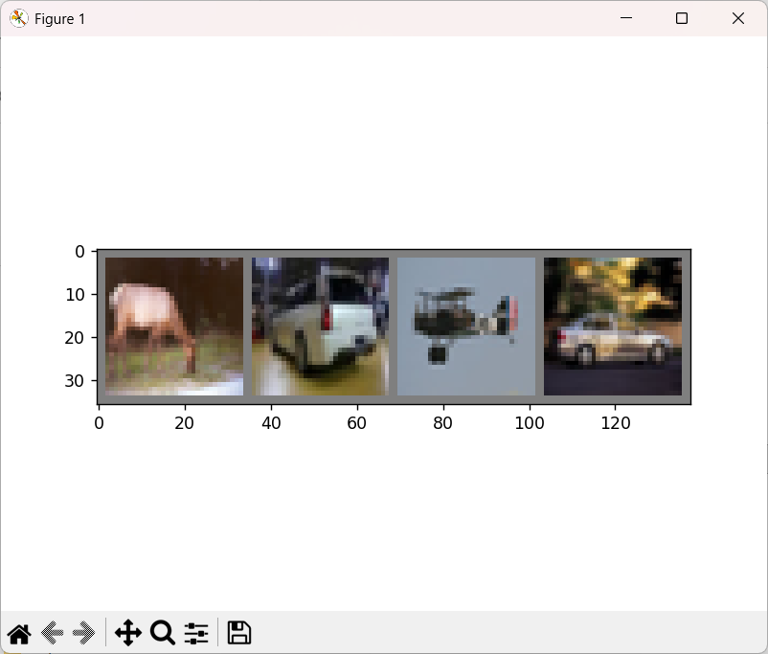
C:\Users\user\anaconda3\envs\torch5800\python.exe E:\Pytorch\L005_CNN\LeNetCIFAR10.py
deer car plane car
[1, 2000] loss: 2.231
[1, 4000] loss: 1.862
…
[20, 10000] loss: 0.659
[20, 12000] loss: 0.684
Finished Training
Accuracy of the network on the 10000 test images: 62 %
Process finished with exit code 0

Slide 32
Lab 3 CatDogCNN.py
import torch from torch import nn from torch.utils.data import DataLoader from torchvision import datasets import torchvision.transforms as transforms import torch.nn.functional as F import torch.optim as optim import matplotlib.pyplot as plt transforms = transforms.Compose([ transforms.Resize((32, 32)), transforms.ToTensor(), transforms.Normalize(mean=(0.5, 0.5, 0.5), std=(0.5, 0.5, 0.5)), ]) # Download training data from Image Folder dataAll = datasets.ImageFolder( root="../data/kagglecatsanddogs_5340/PetImages", transform = transforms, ) num_datapoints = len(dataAll) print(num_datapoints) # split training data into two parts # training_set(70%) # validation_set(30%) train_size = int(0.7 * len(dataAll)) test_size = len(dataAll) - train_size train_set, test_set = torch.utils.data.random_split(dataAll, [train_size, test_size]) # Create data loaders. batch_size = 16 train_dataloader = DataLoader(train_set, batch_size=batch_size, shuffle = True) test_dataloader = DataLoader(test_set, batch_size=batch_size, shuffle = True) # Get cpu or gpu for training. device = "cuda" if torch.cuda.is_available() else "cpu" print(f"Using {device} device") classes = ('Cat', 'Dog') class Net(nn.Module): def __init__(self): super(Net, self).__init__() self.conv1 = nn.Conv2d(3, 6, 5) self.pool = nn.MaxPool2d(2, 2) self.conv2 = nn.Conv2d(6, 16, 5) self.fc1 = nn.Linear(16 * 5 * 5, 120) self.fc2 = nn.Linear(120, 84) self.fc3 = nn.Linear(84, 10) def forward(self, x): x = self.pool(F.relu(self.conv1(x))) x = self.pool(F.relu(self.conv2(x))) x = x.view(-1, 16 * 5 * 5) x = F.relu(self.fc1(x)) x = F.relu(self.fc2(x)) x = self.fc3(x) return x net = Net() criterion = nn.CrossEntropyLoss() optimizer = optim.SGD(net.parameters(), lr=0.001, momentum=0.9) learnloss = [] for epoch in range(5): # loop over the dataset multiple times running_loss = 0.0 size = len(train_dataloader) print(f"Training epoch {epoch+1}") for i, data in enumerate(train_dataloader, 0): # get the inputs inputs, labels = data # zero the parameter gradients optimizer.zero_grad() # forward + backward + optimize outputs = net(inputs) loss = criterion(outputs, labels) loss.backward() optimizer.step() # print statistics running_loss += loss.item() learnloss.append(running_loss/size) print(learnloss) plt.plot(learnloss) plt.show() print('Finished Training') correct = 0 total = 0 with torch.no_grad(): for data in test_dataloader: images, labels = data outputs = net(images) _, predicted = torch.max(outputs.data, 1) total += labels.size(0) correct += (predicted == labels).sum().item() print('Accuracy of the network on the 10000 test images: %d %%' % (100 * correct / total))

Slide 33
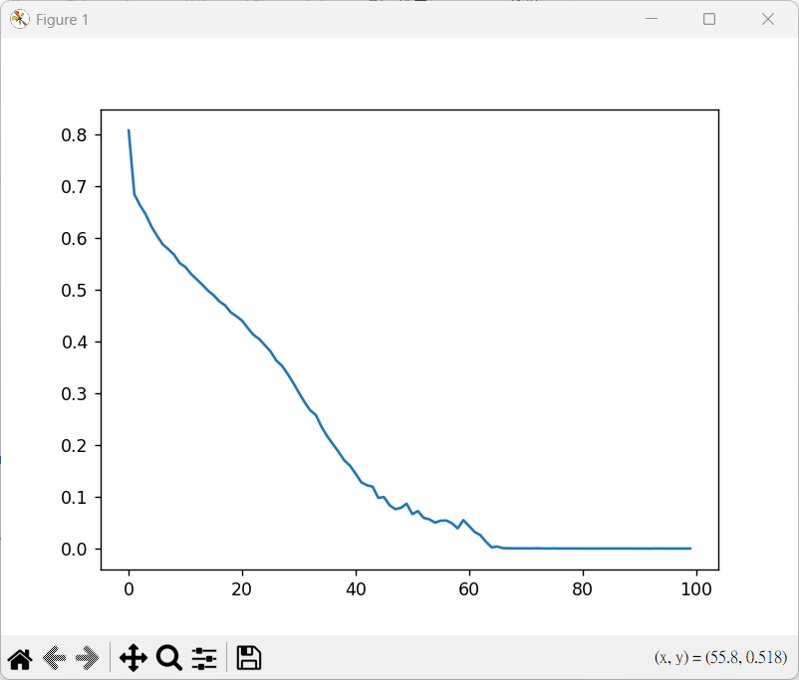
C:\Users\user\anaconda3\envs\torch5800\python.exe E:\Pytorch\L005_CNN\CatDogCNN.py
24997
Using cuda device
Training epoch 1
Training epoch 2
…
Training epoch 99
Training epoch 100
[0.8084878704665566, 0.6851287069551688,
…
0.0003145819692422508, 0.00040233017752000256]
Finished Training
C:\Users\user\anaconda3\envs\torch5800\Lib\site-packages\PIL\TiffImagePlugin.py:949: UserWarning: Truncated File Read
warnings.warn(str(msg))
Accuracy of the network on the 10000 test images: 73 %
Process finished with exit code 0

Slide 34
Lab 4 CatDogVGG16.py
# cats and dogs classification using VGG16 import torch from torch.autograd import Variable import torchvision from torchvision import datasets, transforms, models import matplotlib.pyplot as plt import os import time path = "dog_vs_cat" transform = transforms.Compose([transforms.Resize((224, 224)), transforms.ToTensor(), transforms.Normalize([0.5, 0.5, 0.5], [0.5, 0.5, 0.5])]) data_image = {x: datasets.ImageFolder(root=os.path.join(path, x), transform=transform) for x in ["train", "val"]} print(data_image) data_loader_image = {x: torch.utils.data.DataLoader(dataset=data_image[x], batch_size=4, shuffle=True) for x in ["train", "val"]} # show information use_gpu = torch.cuda.is_available() print(use_gpu) classes = data_image["train"].classes classes_index = data_image["train"].class_to_idx print(classes) print(classes_index) print("train data set:", len(data_image["train"])) print("validation data set:", len(data_image["val"])) # show image X_train, y_train = next(iter(data_loader_image["train"])) mean = [0.5, 0.5, 0.5] std = [0.5, 0.5, 0.5] img = torchvision.utils.make_grid(X_train) img = img.numpy().transpose((1, 2, 0)) img = img * std + mean print([classes[i] for i in y_train]) plt.imshow(img) plt.show() model = models.vgg16() print(model) for parma in model.parameters(): parma.requires_grad = False model.classifier = torch.nn.Sequential(torch.nn.Linear(25088, 4096), torch.nn.ReLU(), torch.nn.Dropout(p=0.5), torch.nn.Linear(4096, 4096), torch.nn.ReLU(), torch.nn.Dropout(p=0.5), torch.nn.Linear(4096, 2)) for index, parma in enumerate(model.classifier.parameters()): if index == 6: parma.requires_grad = True if use_gpu: model = model.cuda() cost = torch.nn.CrossEntropyLoss() optimizer = torch.optim.Adam(model.classifier.parameters()) print(model) n_epochs = 100 for epoch in range(n_epochs): since = time.time() print("Epoch {}/{}".format(epoch, n_epochs)) print("-" * 10) for param in ["train", "val"]: if param == "train": model.train = True else: model.train = False running_loss = 0.0 running_correct = 0 batch = 0 for data in data_loader_image[param]: batch += 1 X, y = data if use_gpu: X, y = Variable(X.cuda()), Variable(y.cuda()) else: X, y = Variable(X), Variable(y) optimizer.zero_grad() y_pred = model(X) _, pred = torch.max(y_pred.data, 1) loss = cost(y_pred, y) if param == "train": loss.backward() optimizer.step() running_loss += loss.data.item() running_correct += torch.sum(pred == y.data) if batch % 5 == 0 and param == "train": print("Batch {}, Train Loss:{:.4f}, Train ACC:{:.4f}".format( batch, running_loss / (4 * batch), 100 * running_correct / (4 * batch))) epoch_loss = running_loss / len(data_image[param]) epoch_correct = 100 * running_correct / len(data_image[param]) print("{} Loss:{:.4f}, Correct:{:.4f}".format(param, epoch_loss, epoch_correct)) now_time = time.time() - since print("Training time is:{:.0f}m {:.0f}s".format(now_time // 60, now_time % 60)) data_test_img = datasets.ImageFolder(root="dog_vs_cat/test/", transform=transform) data_loader_test_img = torch.utils.data.DataLoader(dataset=data_test_img, batch_size=16) image, label = next(iter(data_loader_test_img)) images = Variable(image) if use_gpu: images = images.cuda() y_pred = model(images) _, pred = torch.max(y_pred.data, 1) print(pred) img = torchvision.utils.make_grid(image) img = img.numpy().transpose(1, 2, 0) mean = [0.5, 0.5, 0.5] std = [0.5, 0.5, 0.5] img = img * std + mean plt.imshow(img) plt.show() print('done!')

Slide 35
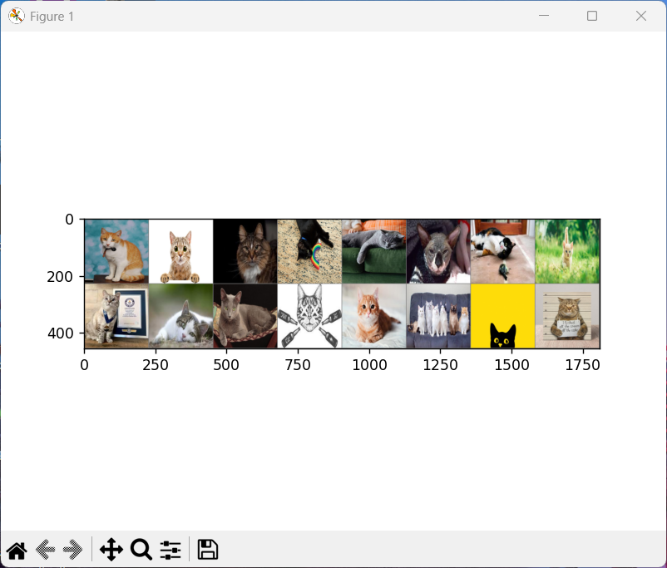
Batch 6180, Train Loss:0.1733, Train ACC:49.8220
Batch 6185, Train Loss:0.1733, Train ACC:49.8141
Batch 6190, Train Loss:0.1733, Train ACC:49.8183
Batch 6195, Train Loss:0.1733, Train ACC:49.8103
Batch 6200, Train Loss:0.1733, Train ACC:49.8065
Batch 6205, Train Loss:0.1733, Train ACC:49.8147
Batch 6210, Train Loss:0.1733, Train ACC:49.8309
Batch 6215, Train Loss:0.1733, Train ACC:49.8270
Batch 6220, Train Loss:0.1733, Train ACC:49.8272
Batch 6225, Train Loss:0.1733, Train ACC:49.8153
Batch 6230, Train Loss:0.1733, Train ACC:49.8114
Batch 6235, Train Loss:0.1733, Train ACC:49.8075
Batch 6240, Train Loss:0.1733, Train ACC:49.8197
Batch 6245, Train Loss:0.1733, Train ACC:49.8239
Batch 6250, Train Loss:0.1733, Train ACC:49.8000
train Loss:0.1733, Correct:49.8060
val Loss:0.1742, Correct:50.0898
Training time is:2m 36s
tensor([0, 0, 0, 0, 0, 0, 0, 0, 0, 0, 0, 0, 0, 0, 0, 0], device='cuda:0')
done!

